Slide 1
MECHANICS OF SOLIDS-I (MEC-203A)
Unit – I
Introduction of Simple Stresses and Strains
By
Dr. Sandeep Khatkar
Assistant Professor (Guest Faculty)
Mechanical Engineering Department

Slide 2
Content
Introduction
What is Load?
Types of Load
What is Stress?
Types of Stress
What is Strain?
Types of Strain
Poisson’s Ratio

Slide 3
Outcomes
DEFINE Various types of stresses and strain developed on determinate and indeterminate member.

Slide 4
Introduction
In day-to-day work, an engineer comes across certain materials, i.e. steel, angle irons, circular bars, cement etc. which are used in his projects.
Solid Mechanics defined as ability, to resist its failure & behaviour, under the action of external forces.

Slide 5
Load
Any engineering design which is built up of a number of members is in equilibrium under the action of external forces and the reactions at the point of support.
Each individual member of the design is subjected to external forces which constitute the load on the member.

Slide 6
Types of Load
Load
Surface Load
Linearly Distributed Load
Tensile Load
Compressive Load
UDL
Impact Load
UVL
Point Load
Axial Load
Eccentric Load

Slide 7
Types of Load
Surface Load
Linearly Distributed Load
Forces acting on a surface
F (Surface Load)
F (Linearly Distributed Load)

Slide 8
Types of Load
Point Load/ Concentrated Load
Axial Load
Axial Load
Point Load/Concentrated Load

Slide 9
Types of Load
Eccentric Load
Uniformly Distributed Load
Eccentric Load
Point Load
Uniformly Distributed Load

Slide 10
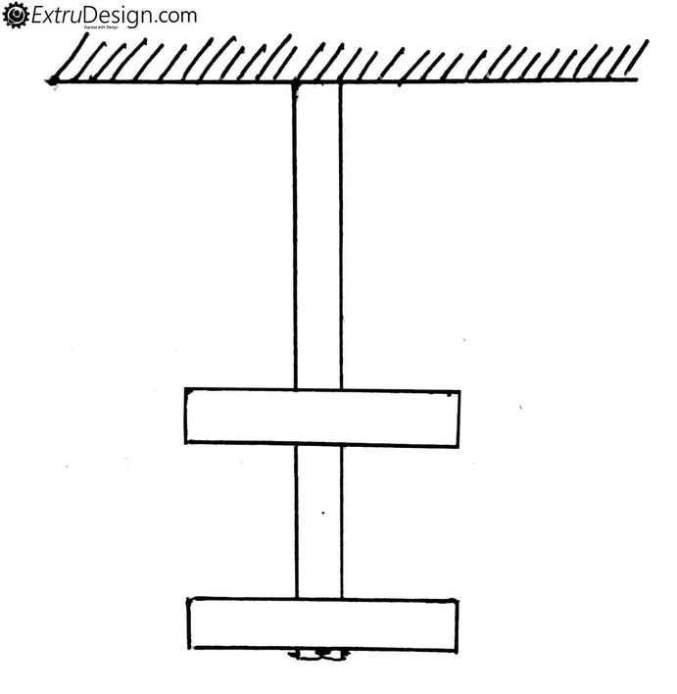
Types of Load
Uniform Varying Load
Impact Load
Uniform Varying Load

Slide 11
Types of Load
Tensile Load
Compressive Load

Slide 12
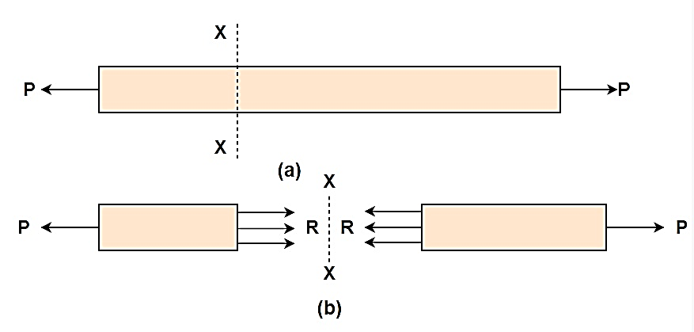
Stress
The force of resistance offered by a body against the deformation is called the stress.
$$Stress=\frac{Resistive Force}{Cross−sectional Area}$$
$$σ=\frac{R}{A}=\frac{P}{A} (\frac{N}{m^{2}} or \frac{N}{{mm}^{2}})$$

Slide 13
Types of Stress

Slide 14
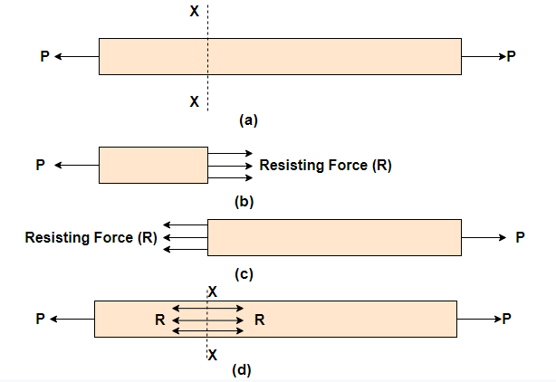
Stress
Direct Stresses
Normal Stresses: Normal stress is the stress which acts in a direction perpendicular to the area.
Tensile Stress
$$∴Tensile Stress \left(σ_{T}\right)=\frac{Resisting force (R)}{Cross−sectional Area}$$
$$=\frac{Tensile Load (P)}{Cross−sectional Area}$$
$$∴σ_{T}=\frac{R}{A}=\frac{P}{A}$$

Slide 15
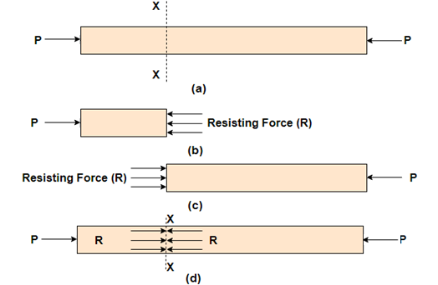
Stress
Direct Stresses
Normal Stresses: Normal stress is the stress which acts in a direction perpendicular to the area.
Compressive Stress
$$∴Tensile Stress \left(σ_{T}\right)=\frac{Resisting force (R)}{Cross−sectional Area}$$
$$=\frac{Tensile Load (P)}{Cross−sectional Area}$$
$$∴σ_{T}=\frac{R}{A}=\frac{P}{A}$$

Slide 16
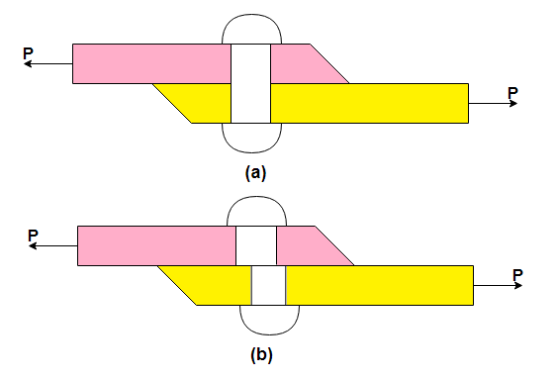
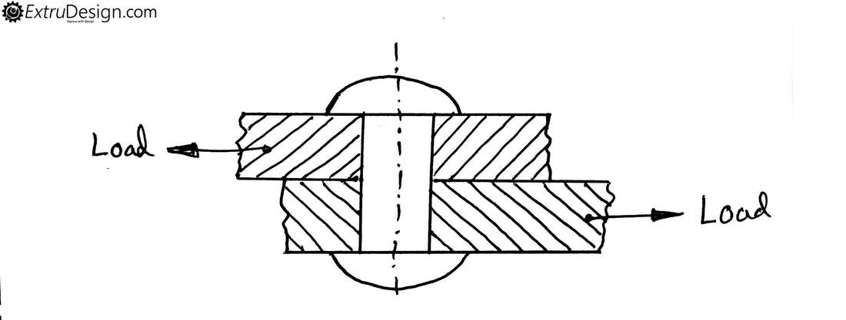
Stress
Direct Stresses
Shear Stresses:
$$Shear Stress=\frac{Shear Resistance}{Shear Area}$$
$$τ=\frac{P}{A}$$

Slide 17
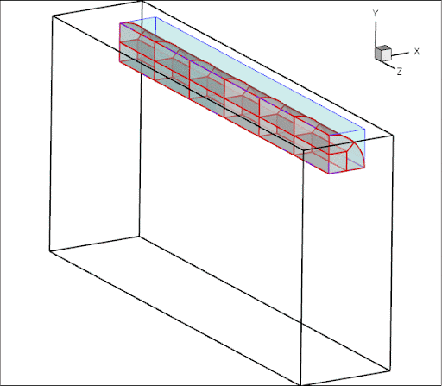
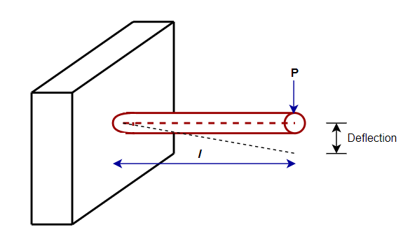
Stress
Indirect Stresses
Bending Stress:
$$M_{max}=P×l (N.m)$$

Slide 18
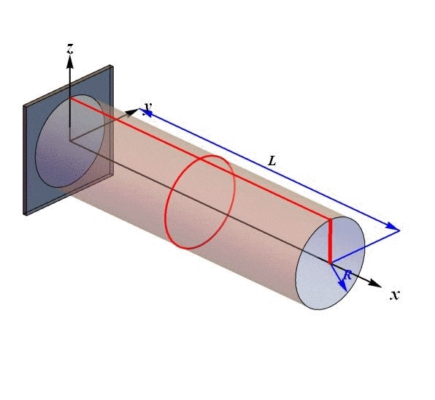
Stress
Indirect Stresses
Torsion:
$$τ=F×r (N.m)$$

Slide 19
Stress
Combined Stresses
Bending + Torsion:

Slide 20
Strain
Strain is a measure of the deformation produced in the member by the load.
The change in dimension divided by original dimension is defined as strain.
$$∴Strain \left(e\right)=\frac{Change in dimesion}{Original dimension}$$

Slide 21
Types of Strain

Slide 22
Types of Strain
Linear Strain / Longitudinal Strain
Deformation of body along the direction of applied force is known as Linear strain or Longitudinal strain
Tensile Strain
$$Tensile Strain= \frac{Change in Length}{Original Length}=\frac{δl}{l}$$

Slide 23
Types of Strain
Linear Strain / Longitudinal Strain
Compressive Strain
$$Compressive Strain= \frac{Change in Length}{Original Length}=\frac{δl}{l}$$

Slide 24
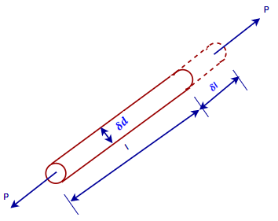
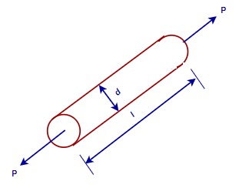
Types of Strain
Lateral Strain
$$Tensile Strain= \frac{Change in Diameter}{Original Diameter}=\frac{δd}{d}$$

Slide 25
Poisson’s Ratio
It is a ration of lateral strain to linear strain is known as poisson’s ratio.
$$Poisson^{′}s ratio(μ)= \frac{Lateral Strain}{Linear Strain}$$

Slide 26
Part- 2
Hooke’s Law
Stress-Strain Diagram (Ductile Material)
Stress-Strain Diagram (Brittle Material)
Factor of Safety
Simple Numerical

Slide 27
Thank you !!!

